Slide 1

COMM223 Marketing Management
Lecture 2 - Marketing Strategy Marketing Environment
SWOT

Slide 2
Agenda
Chapter 2: company and marketing strategy
Marketing strategy and Marketing mix
Managing marketing effort
Chapter 3 marketing environment
Microenvironment
Macroenvironment
Company analysis-SWOT

Slide 3
Marketing Strategy
The marketing logic by which the the company hopes to create customer value and achieve profitable customer relationships
市场策略
公司希望通过这种营销逻辑来创造客户价值并实现盈利的客户关系
Marketing Mix
The set of tactical marketing tools – product, price, place, and promotion – that the firm blends to produce the response it wants in the target market
营销组合
一套战术营销工具——产品、价格、地点和促销——公司混合在一起以在目标市场产生它想要的反应

Slide 4
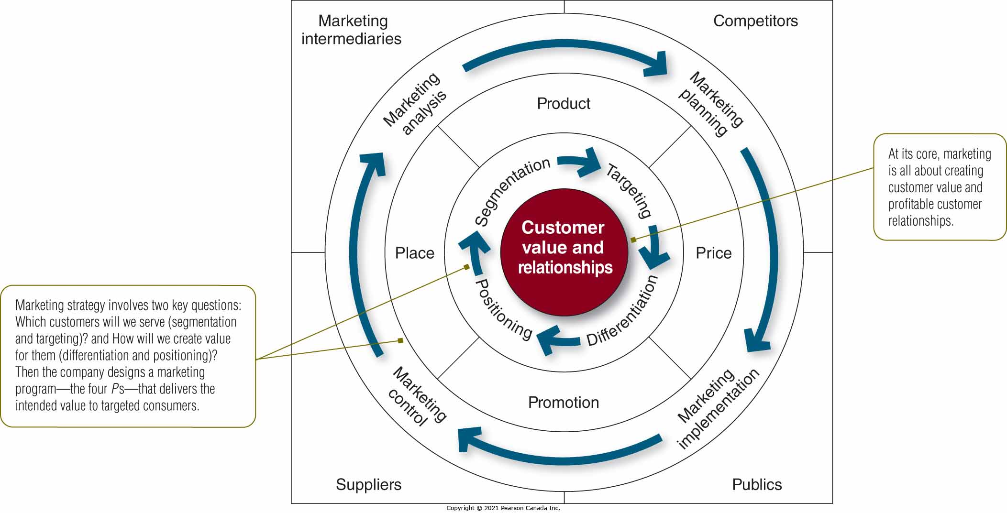
Marketing Strategy and the Marketing Mix

Slide 5
Marketing Strategy and the Marketing Mix
Companies must be customer centred
Process:
Customer analysis
Segmentation
Market Targeting
Market Differentiation
Positioning
公司必须以客户为中心
过程：
客户分析
分割
市场定位
市场差异化
定位

Slide 6
Marketing Strategy and the Marketing Mix
Market segmentation
Dividing a market into distinct groups of buyers who have different needs, characteristics, or behaviours, and who might require separate products or marketing programs
将市场划分为具有不同需求、特征或行为的不同买家群体，他们可能需要单独的产品或营销计划
Market targeting
Evaluating each market segment’s attractiveness and selecting one or more segments to enter评估每个细分市场的吸引力并选择一个或多个细分市场进入

Slide 7
Positioning the product to occupy a clear, distinctive, and desirable place relative to competing products
将产品定位为相对于竞争产品占据清晰、独特和理想的位置
差异化市场产品以创造卓越的客户价值
整个营销计划应支持所选的定位策略。
Differentiating the market offering to create superior customer value
The entire marketing program should support the chosen positioning strategy.

Slide 8
Developing the Marketing Mix营销组合
The marketing mix includes controllable and tactical marketing tools knows as the 4Ps
The 4Ps include
Product
Place
Promotion
Price

Slide 9
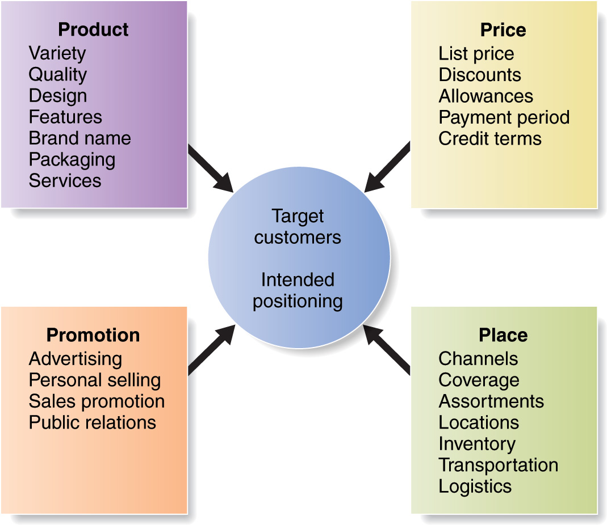
The Marketing Mix

Slide 10
The 4 P’s Versus 4 C’s/A’s
The 4 P’s takes the seller’s view of market, not the buyer’s.
Product
Customer solution/Acceptability
Price
Customer cost/Affordability
Place
Convenience/Accessibility
Promotion
Communication/Awareness

Slide 11
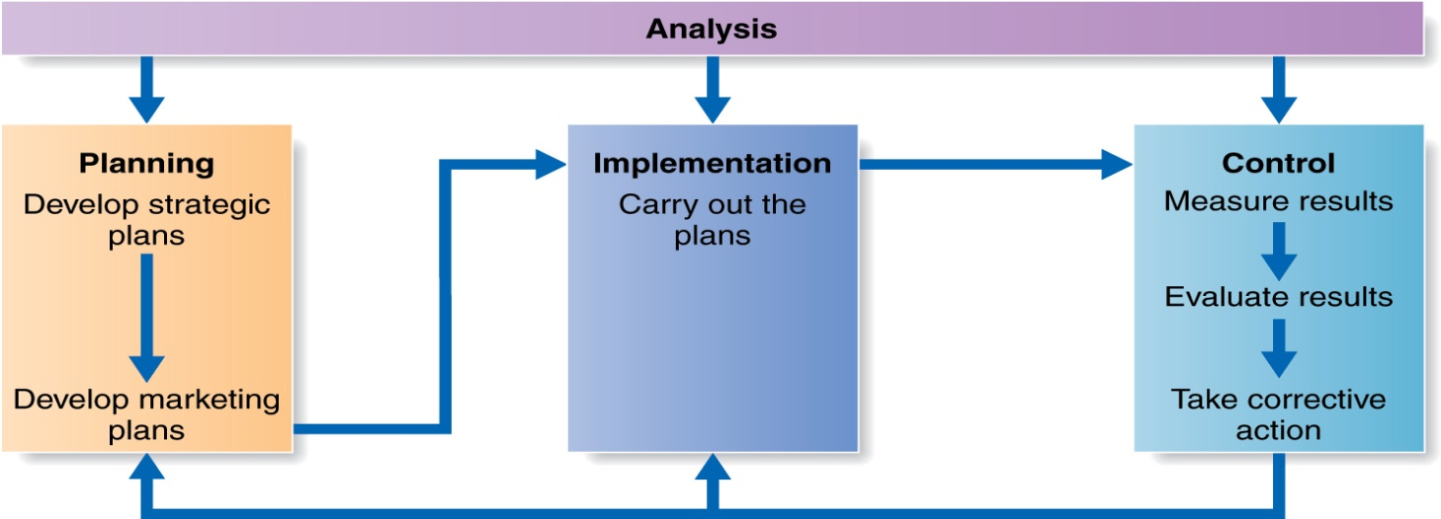
Managing the Marketing Effort
4 marketing management functions:
Marketing Analysis: internal analysis (strengths/weaknesses), external analysis (opportunities and threats)
Marketing Planning: deciding on marketing strategies to attain objectives
Implementation: turning plans into action (“doing things right” is as important as “doing the right things”)
Control: evaluating results (operational control, strategic control)

Slide 12
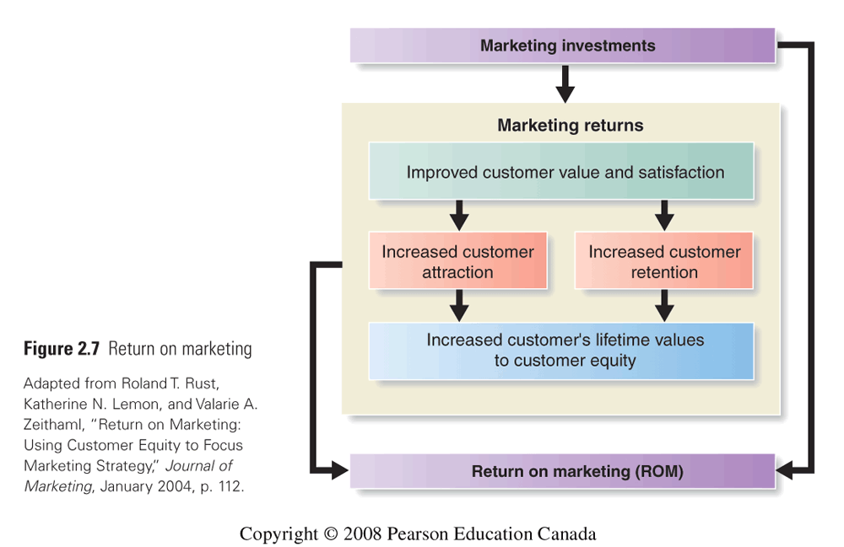
Measuring and Managing Return on Marketing
Return on marketing (marketing ROI)
The net return from a marketing investment divided by the costs of the investments

Slide 13

Video Case:
Rollerblade, Inc.

Slide 14
In-Line Skates
Invented in 1700s
Standard design till 1863, when roller (pair) skates arrived
1980 - rediscovered, improved
polyurethane wheels, molded boot shell, heel brakes
“Rollerblade skates” marketed to hockey players and skiers as a means of staying in shape during summer
image - training product for other sports
Mid-1980, Mary Horwath brought in

Slide 15
Rollerblade
Conversations with in-line skaters suggested that “rollerblading”:
was incredible fun
was a great aerobic workout
would have appeal outside ice skater market

Slide 16
The Changes in Rollerblade, Inc.
BASIS OF COMPARISON
SITUATION
IN 1986
SITUATION
TODAY
Number of competitors
Main Rollerblade marketing objective
Product
Price
Main marketing mix actions
Promotion
Place

Slide 17
Marketing Environment:
The actors and forces outside marketing that affect marketing management’s ability to build and maintain successful relationships with target customers
Microenvironment
Includes the actors close to the company
Macroenvironment
Involves larger societal forces
营销环境：
影响营销管理与目标客户建立和维持成功关系的能力的营销之外的参与者和力量
微环境
包括与公司关系密切的演员
宏观环境
涉及更大的社会力量

Slide 18
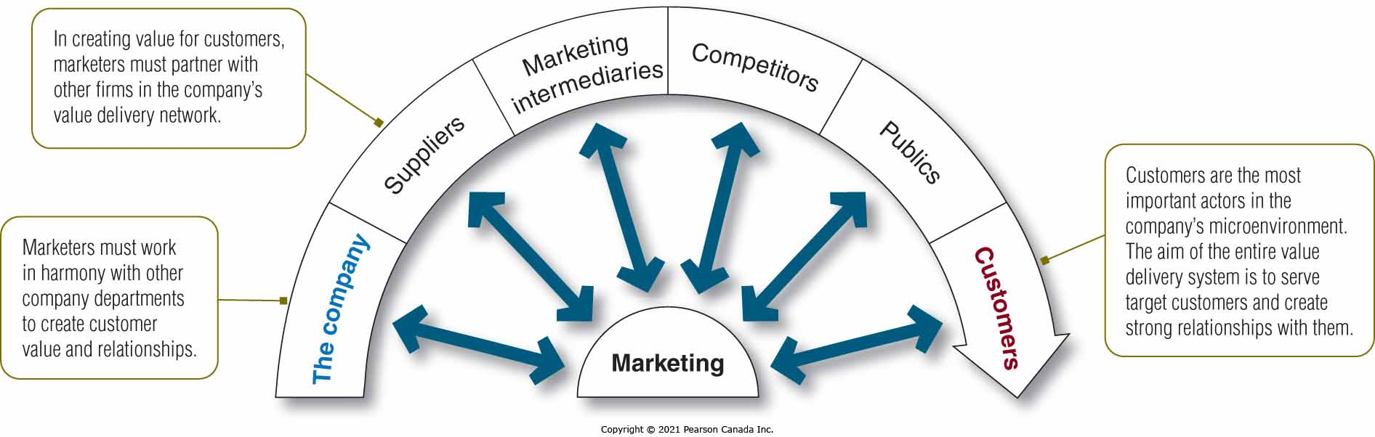
Microenvironment

Slide 19
Microenvironment The Company
Interrelated groups in a company form the internal environment
Departments share the responsibility for understanding customer needs and creating customer value.
公司内部相互关联的群体形成内部环境
各部门共同承担了解客户需求和创造客户价值的责任。

Slide 20
Microenvironment Suppliers
Provide the resources needed by the company to produce its goods and services
Supplier problems seriously affect marketing
Supply shortages or delays
Labor strikes
Price trends of key inputs
提供公司生产商品和服务所需的资源
供应商问题严重影响营销
供应短缺或延误
劳工罢工
关键投入的价格趋势

Slide 21
Microenvironment Marketing Intermediaries
Marketing intermediaries help the company to promote, sell, and distribute its products to final buyers.
Resellers
Physical distribution firms
Marketing services agencies
Financial intermediaries
营销中介帮助公司向最终买家推广、销售和分销其产品。
经销商
物流公司
营销服务机构
金融中介机构

Slide 22
Microenvironment Customers
Five types of customer markets
Consumer markets
Business markets
Reseller markets
Government markets
International markets
五类客户市场
消费市场
商业市场
经销商市场
政府市场
国际市场

Slide 23
Microenvironment Competitors
Marketers must gain strategic advantage by positioning products strongly against competitors.
No single strategy is best for all companies.
营销人员必须通过对竞争对手的强烈定位来获得战略优势。
没有一种策略对所有公司都是最好的。

Slide 24
Microenvironment Publics
Publics: any group that has an actual or potential interest in or impact on an organization’s ability to achieve its objectives
公众：对组织实现其目标的能力有实际或潜在利益或影响的任何团体
Financial
Media
Government
Citizen action
Local
General
Internal

Slide 25
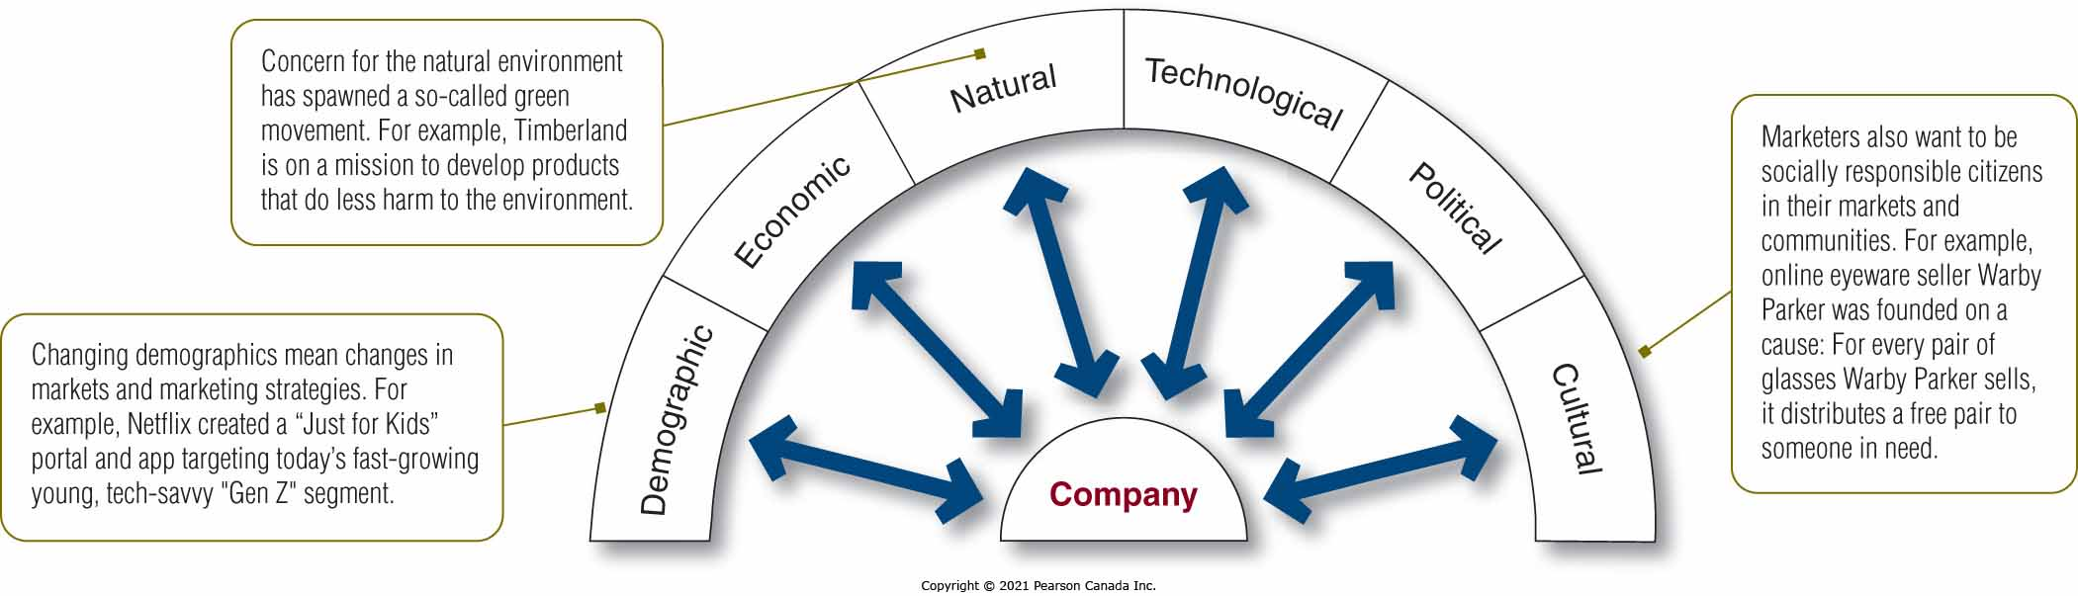
Macroenvironment

Slide 26
Macroenvironment Demographic Environment
Demography is the study of human populations in terms of size, density, location, age, gender, race, occupation, and other statistics.
Marketers analyze:
Changing age and family structures
Geographic population shifts
Educational characteristics
Population diversity
人口学是对人口规模、密度、位置、年龄、性别、种族、职业和其他统计数据的研究。
营销人员分析：
改变年龄和家庭结构
地理人口变化
教育特色
人口多样性

Slide 27
Macroenvironment Demographic Environment
The Canadian population contains several generational groups:
Baby Boomers
Generation X
Millennials (or Generation Y)
Generation Z
Generational Marketing
加拿大人口包含几个世代群体：
婴儿潮一代
X世代
千禧一代（或 Y 世代）
Z世代
代际营销

Slide 28
Macroenvironment Demographic Environment
The Changing Canadian Family
Geographic Shifts in Population
A Better-Educated, More White-Collar, More Professional Population
Increasing Diversity
不断变化的加拿大家庭
人口的地理变化
受过更好教育、更白领、更专业的人群
增加多样性

Slide 29
Demographics are Easy to Predict
Therefore
Companies Should be Aware of Them!!

Slide 30
Macroenvironment Economic Environment
Factors that affect consumer buying power and spending patterns
Changes in Income
Marketers should pay attention to income distribution as well as average income.
Upper class, middle class, working class, and underclass
The distribution of income has created a two-tiered market: the affluent（wealthy） and the less affluent
影响消费者购买力和消费模式的因素
收入变化
营销人员应注意收入分配以及平均收入。
上层阶级、中产阶级、工人阶级和下层阶级
收入分配创造了一个两级市场：富裕的（富裕的）和较不富裕的

Slide 31
Macroenvironment Natural Environment
Physical environment and natural resources needed as inputs by marketers or affected by marketing activities
Environmental sustainability concerns have grown steadily over the past three decades.
Trends:
Shortages of raw materials
Increased pollution
Increased government intervention
作为营销人员投入或受营销活动影响所需的物理环境和自然资源
在过去的三年中，环境可持续性问题稳步增长。
趋势：
原材料短缺
污染增加
增加政府干预

Slide 32
Macroenvironment Technological Environment
The most dramatic force shaping our world
Rapidly changing force which creates many new marketing opportunities but also turns many existing products extinct
Government agencies to regulate new product safety
塑造我们世界的最具戏剧性的力量
快速变化的力量创造了许多新的营销机会，但也使许多现有产品灭绝
政府机构监管新产品安全

Slide 33
Macroenvironment Political Environment
Consists of laws, government agencies, and pressure groups that influence or limit various organizations and individuals in a given society
Legislation affecting businesses worldwide has increased
Laws protect companies, consumers and the interests of society
Increased emphasis on ethics and socially responsible actions
由影响或限制特定社会中各种组织和个人的法律、政府机构和压力团体组成
影响全球企业的立法有所增加
法律保护公司、消费者和社会利益
更加重视道德和社会责任行为

Slide 34
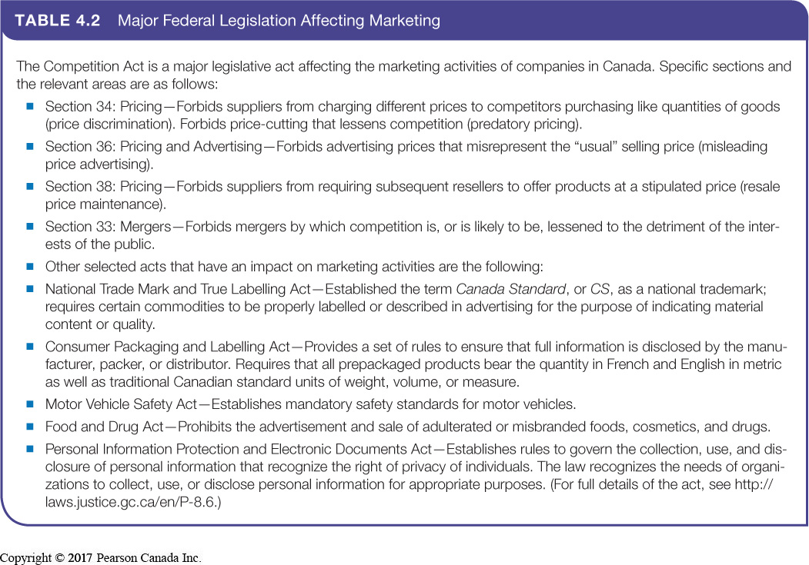

Slide 35
Macroenvironment Cultural Environment
Institutions and other forces that affect a society’s basic values, perceptions, and behaviours
Persistence of cultural values
Core beliefs and values have a high degree of persistence.
Secondary beliefs and values are more open to change.
影响社会基本价值观、观念和行为的制度和其他力量
文化价值的坚持
核心信念和价值观具有高度的坚持性。
次要的信念和价值观更容易改变。

Slide 36
Macroenvironment Cultural Environment Includes people’s views of…
Shifts in secondary cultural values of people’s views about
Themselves
Others
Organizations
Society
Nature
Universe
人们对关于文化的看法的次要文化价值观的转变
他们自己
其他
组织
社会
自然
宇宙

Slide 37
Responding to the Marketing Environment
Reactive firms passively accept the marketing environment and do not try to change it.
Proactive firms develop strategies to change the environment.
They take aggressive actions to affect the publics and forces in their marketing environment.
被动式公司被动地接受营销环境，而不是试图改变它。
积极主动的公司制定战略来改变环境。
他们采取积极的行动来影响营销环境中的公众和力量。

Slide 38
SWOT Analysis
Internal factors (microenvironment) identify Strength and Weakness
External factors (macroenvironment) identify Opportunities and Threats
Together, they form the raw material of the SWOT analysis.
内部因素（微环境）确定强弱
外部因素（宏观环境）识别机会和威胁
它们共同构成了 SWOT 分析的原材料。

Slide 39
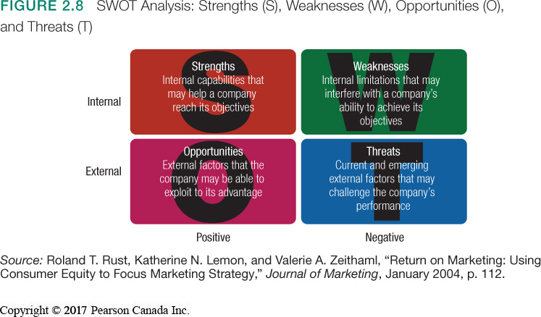

Slide 40
Macroenvironment Analyze Environment - Step 1
1) List “relevant” environment factors
Internal factors (Controllable)
Financial resources
Technological expertise (R&D, patent & MIS, etc.)
Cost Structure
Relationship with suppliers
Relationship with customers
Human resources
External factors (Uncontrollable?)
Competition
Political/Regulatory
Economic
Social/Cultural
Technological
列出“相关”环境因素
内部因素（可控）
金融资源
技术专长（研发、专利和管理信息系统等）
成本结构
与供应商的关系
与客户的关系
人力资源
外部因素（不可控？）
竞赛
政治/监管
经济的
社会/文化
技术

Slide 41
Macroenvironment Analyze Environment - Step 2
2) Evaluate the impact of each relevant factor
Internal factors are usually evaluated against both existing and potential competitive rivals
Positive factors (Strengths)
What are our competitive advantages? What distinct competencies do we have?
Negative factors (Weaknesses)
In what areas are we vulnerable? Do we understand our resource limitations?
评估每个相关因素的影响
内部因素通常根据现有和潜在的竞争竞争对手进行评估
积极因素（优势）
我们的竞争优势是什么？我们有哪些独特的能力？
负面因素（弱点）
我们在哪些领域容易受到攻击？我们了解我们的资源限制吗？

Slide 42
Macroenvironment Analyze Environment - Step2 (cont.)
2) Evaluate the impact of each relevant factor (cont.)
External factors are evaluated with respect to the positive and negative factors just identified
Positive factors (Opportunities)
What might we do? What do we do best? What must we do to take advantage?
Negative factors (Threats)
What are the potential risks? Will we lose our competitive advantage? Are there any obstacles? What are the possible constraints?
评估每个相关因素的影响（续）
外部因素针对刚刚确定的正面和负面因素进行评估
积极因素（机会）
我们能做什么？我们最擅长的是什么？我们必须做什么才能利用？
负面因素（威胁）
有哪些潜在风险？我们会失去竞争优势吗？有什么障碍吗？可能的限制是什么？

Slide 43
Relations among SWOT
Positive
Negative
Strengths
Weaknesses
Internal
Opportunities
Threats
External

Slide 44
Discussion: Starbucks SWOT analysis
Strength:
Weakness:
Opportunities:
Threats:

Slide 45
Find your team members and let me know next class.
Read Chapter 4

